Slide 1
Agile Publishing Framework version 2012
Tools of Change
February 2012
Dominique Raccah
Sourcebooks, Inc.

Slide 2

developing reader (user)-centric models ~
based on your key verticals
Notes:
We are in the infancy of developing this type of model. What’s incredible to me is how big a world it’s opened up. We’re now pretty clear that we talk to basically 3 target audiences. And we’re interested in books, projects, apps, software that solves problems and are of interest to these three groups of people. It’s a radically different approach for a traditional trade book publisher. And it would not surprise me to see us down the road have the company organized along those lines.

Slide 3

developing a publishing roadmap: based on your reader’s needs
Notes:
And you’ll want to develop a roadmap for each piece of your business. What are you trying first, what happens next, what are you building on top of that. And it’s tied to your experiments. Outcomes are positive and you need to be making decisions very quickly.

Slide 4
“You’ve got to start with the customer experience and work back toward the technology — not the other way around.”
—Steve Jobs, May 1997

Slide 5

community network
publishing model
Notes:
This isn’t new. It’s something that’s already Happening in the industry. I put a name to it for myself because it was a way to help me think about the characteristics of the model.
One of the best examples is Oreilly.

Slide 6
community network
publishing model
community of users & content creators (with no strict barriers between the two)
and growing collection of content

Slide 7
community network
publishing model
Community will give you feedback on how to package/format your content
Iterate what content should be
Content format will evolve to better fit the community
Community will connect through your content
Community may add content to your content
More than just print format. How when where content is consumed
Community itself also becomes content
Content will become more modularized to better fit specific user/reader’s needs
Pricing will evolve through the model
Notes:
This is a paradigm shift for publishing.
Tip of iceberg of possibility
Readers→ Guarantee existence of publishers
Moved away from consumerism— buying stuff none of which they’ve used— People have started to reject consumerism
Alienated, afraid, want to connect
More meaning
Internet created Networks + communities
Spending $ on what experience → experiential culture

Slide 8
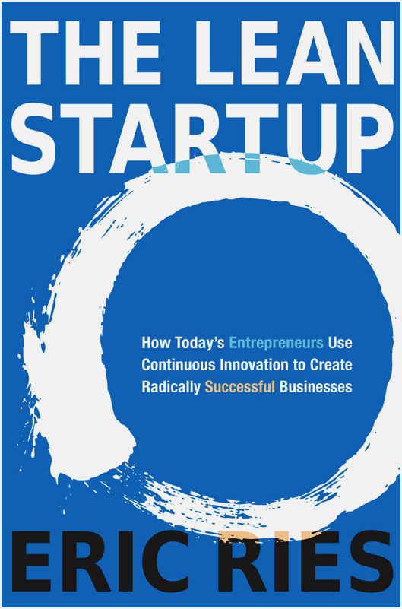

Slide 9
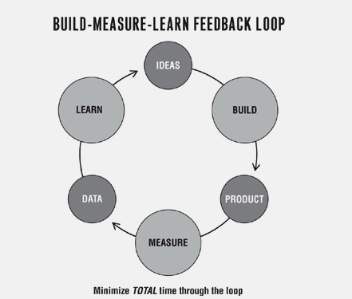
A model for experimentation:
From The Lean Startup

Slide 10
more efficiently build what your users actually want
Notes:
Saw in this process the opportunity to…

Slide 11

Trademark/
Copyright protection
Licensing &
Administration
Accounting;
Royalties
Positioning
Cultural Filter
Content
Development
Physical & Digital
Warehousing
Copyedit and
Proofread
what
book publishers do
Physical Distribution
Content Design
Digital Distribution
Creation of content
portable files
Printing/
Manufacturing
Author branding &
career development
Trade Shows
Niche community
building
PR, Marketing
and Advertising
Creative Partner
Retail Marketing
and Sales
eCommerce
Administration
Notes:
Creating that connection involves a lot of separate tasks. You wouldn’t think it was so many…
1 of the hings that I find intersting is that if you take away all physicial books. That’s 2 of these bubbubles. By the way, feel free to create your own bubbles. They’ll be different then mine. It’ll still be a lot and print is still a minority of what we do. What part of what we do now will authors and/or readers be willing to pay for??

Slide 12
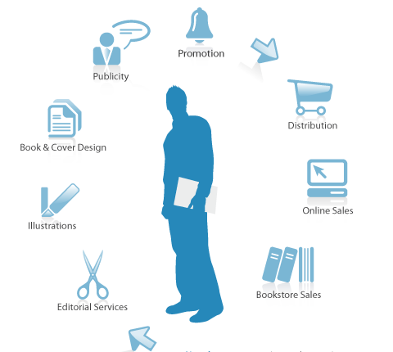
Author frustration

Slide 13

1. Financially

Slide 14
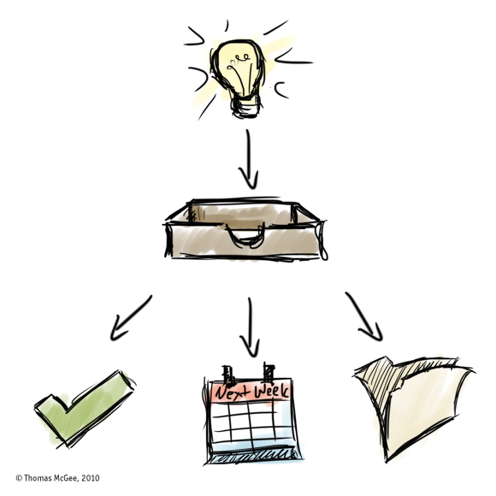
2. By creating better work

Slide 15

3. Providing marketing & sales beyond their own scope

Slide 16
Better author experience?

Slide 17

Problem 3 - timeliness
How do you publish a futurist?

Slide 18
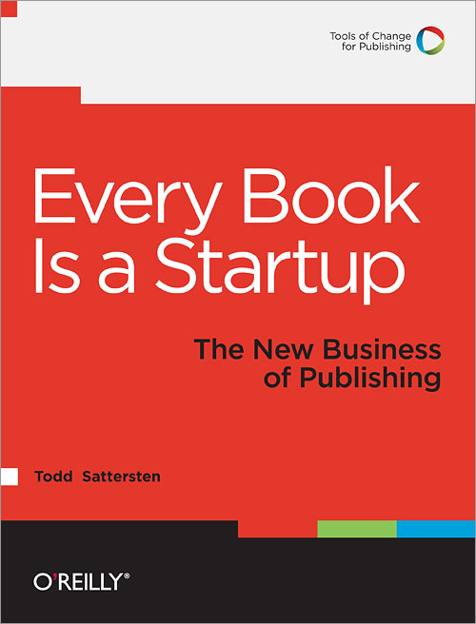
O’Reilly TOC webinar

Slide 19
Agile Publishing Model
Creation + Interaction + Collaboration
= Completed Book
Agile Publishing Model (APM) is a fast-to-market new form of publishing books. The platform allows for rapid and interactive development of books by our authors. Working together the author and community will shape and change the content as the book moves from its initial stages as an interactive, digital platform to the final published product.

Slide 20
Agile Publishing Model – 3 goals
More efficient (successful product development faster)
Better author experience
More timely/updated books

Slide 21

Agile Publishing Model
We’ll be using the APM to develop and publish the book Entering the Shift Age by David Houle
The APM will be dynamic and changing
Right now we see 6 initial guiding principles that could be useful as we start building the APM with the community

Slide 22
Agile Publishing Framework
It’s about creating a conversation between the author and reader.
The author leads the content creation.
The APM is useful for expert-based authors.
It’s about creating a partnership between the author and reader.
The author has support from the publisher.
The APM is a dynamic model that is open and receptive to change.
Notes:
Lots of different tools (it’s not a platform). It’s more.
Framework to help sharpen an author’s vocie
Author drives discussion.
Publisher is the hands.

Slide 23
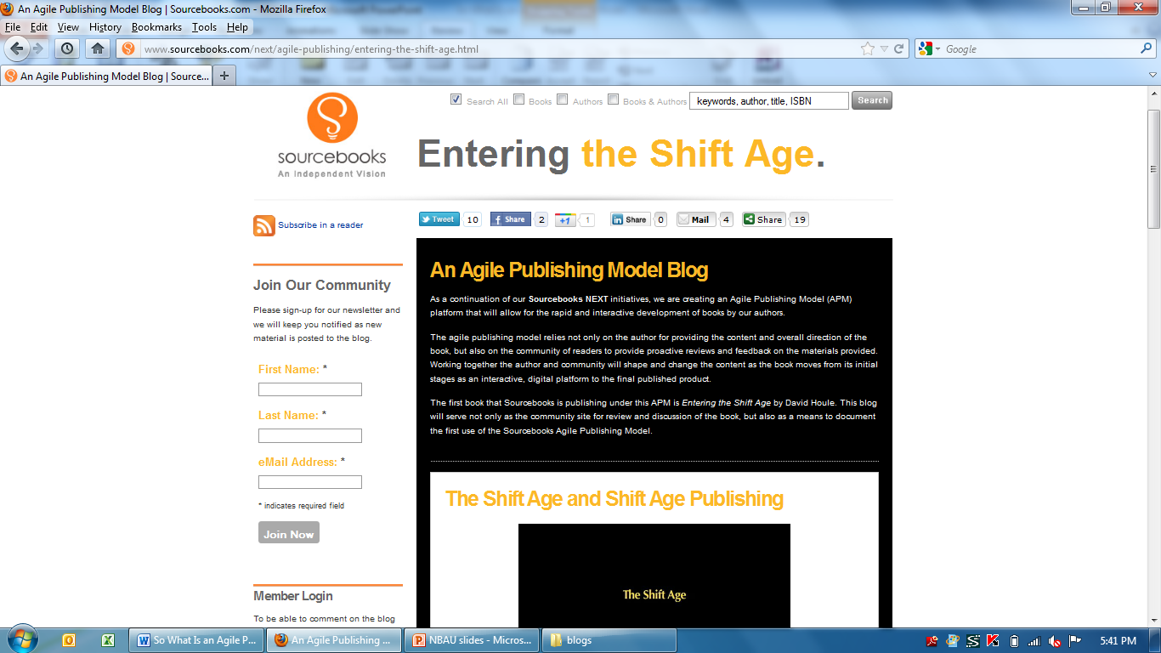
Agile Publishing Framework
Join the conversation!
www.enteringtheshiftage.com

Slide 24
Agile Publishing Framework– 1st steps
Content delivery input
Pricing models survey
New content in 3 stages
What do readers actually do/use?
Preorders?
Notes:
How would you prefer to read content for Entering the Shift Age?

Slide 25
Let’s talk…
Email: dominique.raccah@sourcebooks.com
Twitter: @draccah
LinkedIn Group: Ebooks, Digital Books and Content Publishing Network
Notes:
People walk into a future. It’s with us all the time.
It’s our job as management to create that vision. And to lead and manage into it. We need to create a positive driven business and personal vision for our people to walk into.
We’re at the transformation of the book .it’s happening faster than we ever imagined. What we do, what we choose has never been more important. The next two years will be determinant. And I believe that we, the people of the book, all of us together can create an extraordinary future. We’re here in this room because we love books. Not only love them, but value them…believe in profound ways about the value that books can hold in a person’s life.
We are walking towards a future in which books can be with you always. And not just some books, but any book you choose…any time, any place, any device. We have the opportunity to forever change the face of literacy and education. We are now pioneers in the most old fashioned sense of the word. I look forward to working with you on making that happen.
We are creating a completely new future for the book,for authors, for readers. I hope we’ll have a chance to work together.
We can accomplish more by working together.

